Slide 1
State of the Retail Value Chain
– Crime Risk Seminar

Slide 2
INTRO

Slide 3
“When your neighbour is hungry you will not sleep well”.

Slide 4
A business leader focus every day
Profitable Growth
People Culture and Values
SHE
Stakeholder Management
Strategy
ESG
Risk Management (Security – It is the re-active one most of the time)

Slide 5
Our Security Environment
2022 Indicated a $350bn loss in shrinkage and theft across our Consumer Goods sector in the US.
Cybercrime is expected to cost the world $10.5 trillion annually by 2025
( Phishing, Spear Phishing, Deep Fakes, Social engineering)
Ransomware – 10600 new variants of ransomware in 2022
Kidnappings - Total of 17,061 incidents reported in 2023/2024
South Africa suffers ‘staggering losses’ of around R100 billion a year due to illicit trade, counterfeiting in 2024

Slide 6
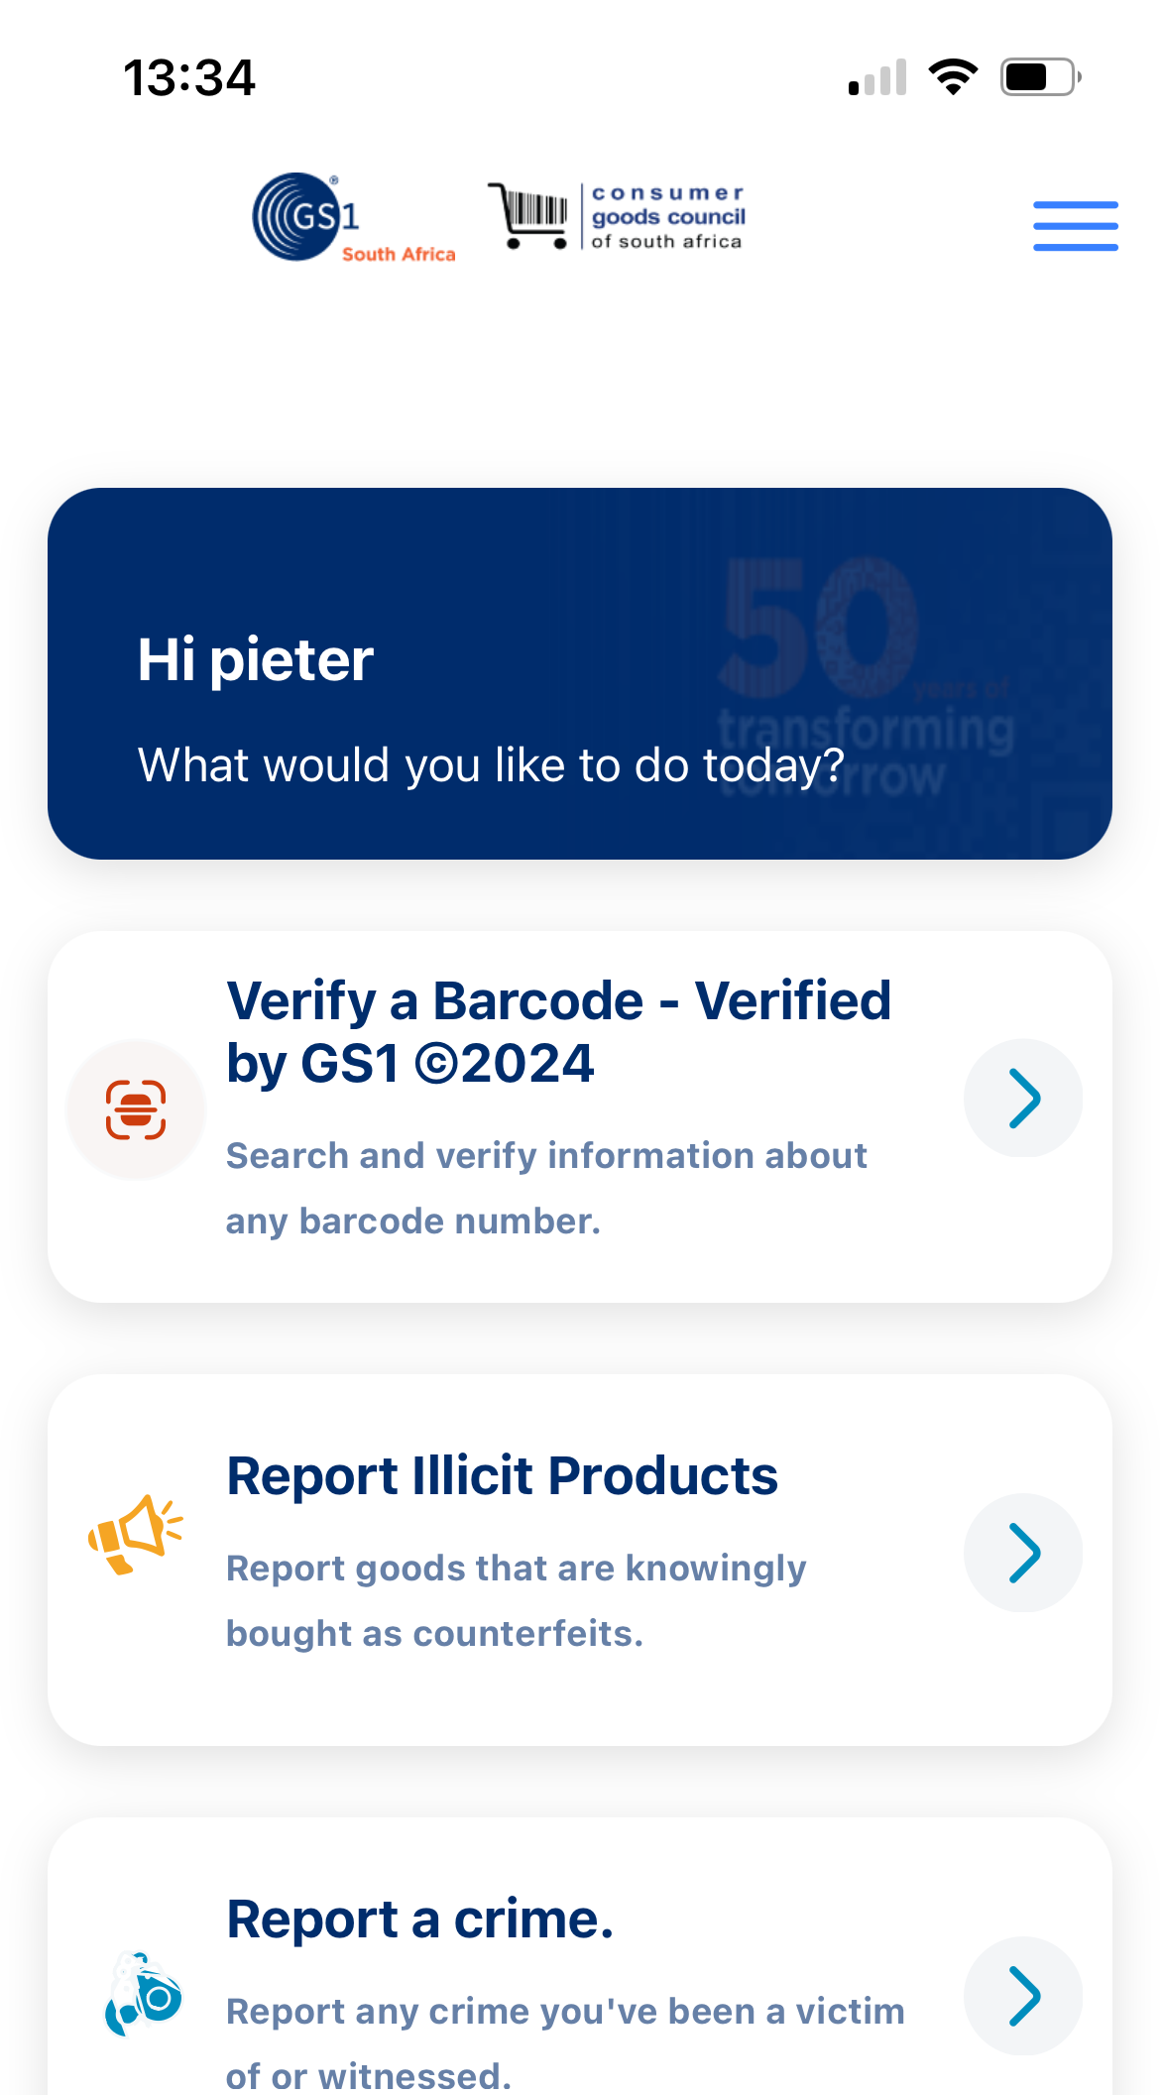
CGSA’s role in co-ordinating the fight against crime
Get the app GS1SouthAfrica
Participate in quarterly meetings.
Share key info crime and social disobedience related with AB

Slide 7
Where to find us
011 777 3300
The Consumer Goods Council of South Africa (CGCSA)
@CGCSA 1
www.cgcsa.co.za
164 Katherine Street, Pinmill Farm Block D, Sandton 2146

